Slide 1
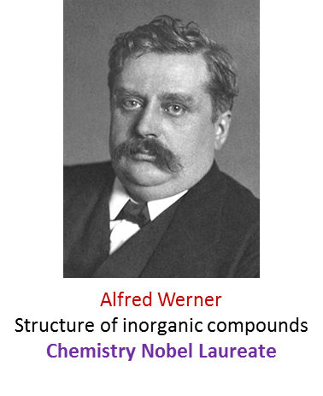
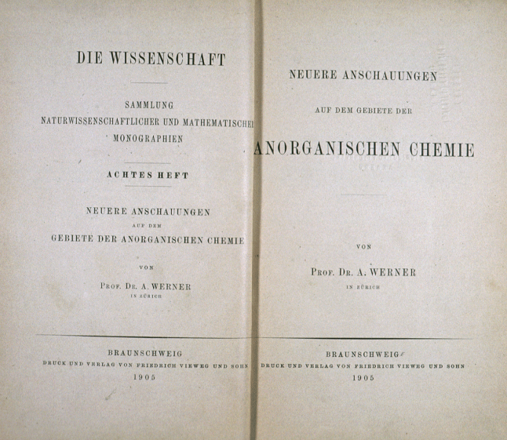
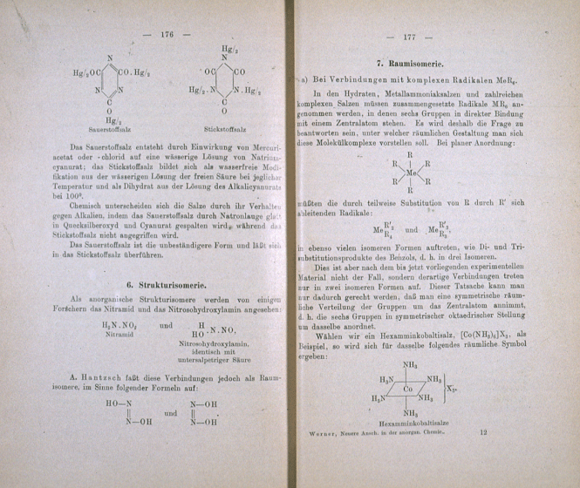
Alfred Werner: Structure of Coordination Complexes
Rules governing the structure of organic compounds were available
by 1880.
No such understanding was developed for inorganic complexes until 1893 when Alfred Werner put forward his theory.
Neuere Anschauungen auf dem Gebiete der Anorganischen Chemie. Braunschweig, 1905

Slide 2
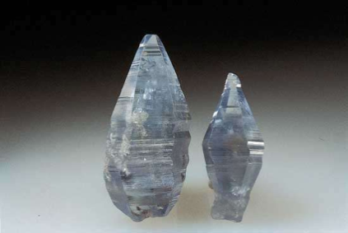

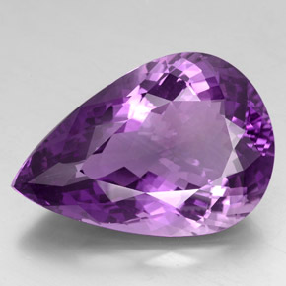
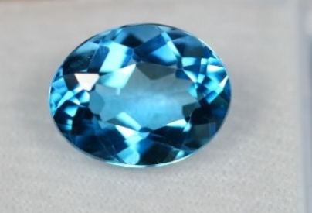
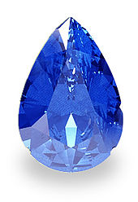
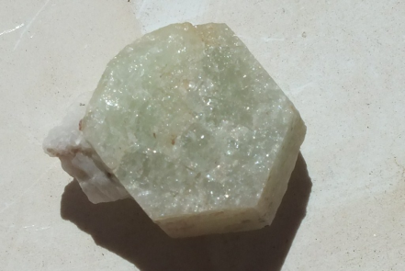
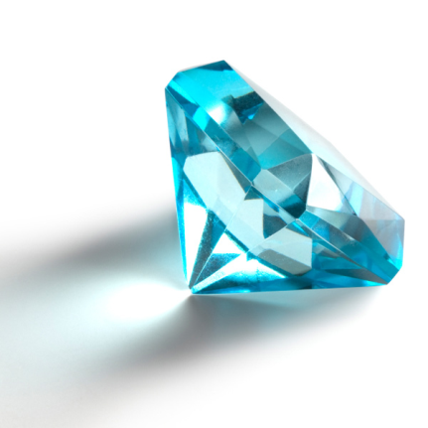
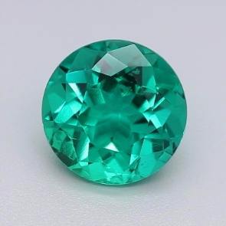
Compounds of Transition Metals
Scientists were perplexed by the nature of compounds made by transition metals.
The interesting properties exhibited by such compounds such as color and magnetism provided impetus to understand their bonding.
All precious/semi-precious stones owe their color to transition metals.
Corundum Mineral
Al₂O₃
Ruby
Cr  Al
Amethyst
Mn  Al
Topaz
Fe  Al
Sapphire
Ti &Co  Al
Beryl mineral,
Be₃ Al ₂Si₆O₁₈
Aquamarine
Fe  Al
Emerald
Cr  Al

Slide 3
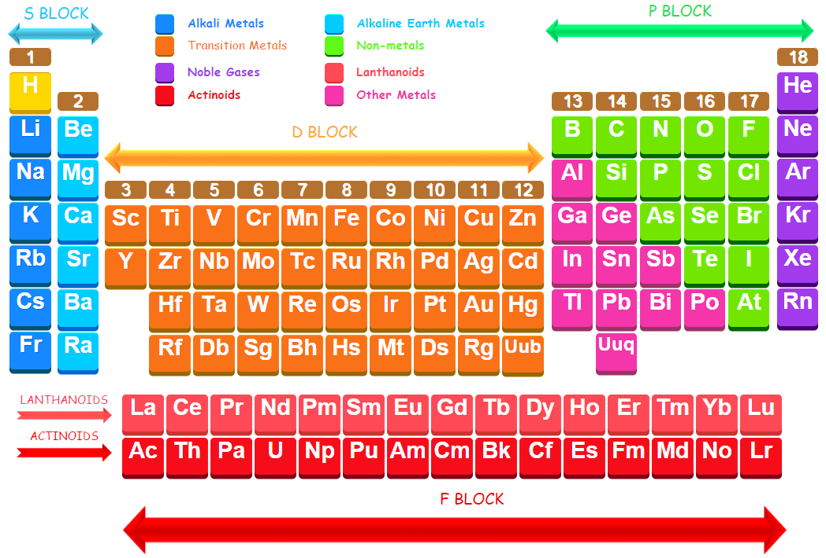
Coordination Complexes of the Transition Elements

Slide 4
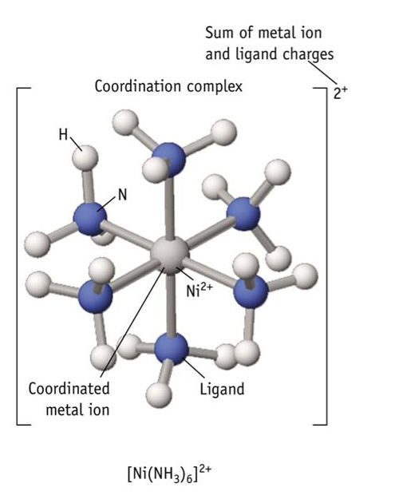
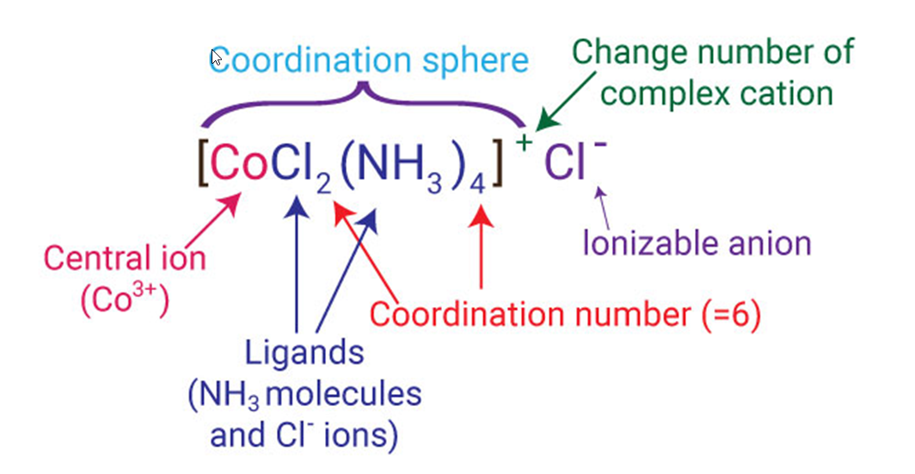
Components of a Coordination Compound
A coordination compounds contains atleast one complex ion, which consists of a central metal cation bonded to “ligands”.
Ligands can be neutral molecules or anions.
A complex ion is associated with counterions of opposite charge.
[Co(NH₃)₅Cl]Cl₂–[Co(NH₃)₅Cl]²⁺ and two Cl⁻; Co is in +3 oxidation state
K₃[Fe(CN)₆]–[Fe(CN)₆]³⁻ and three K⁺; Fe is in +3 oxidation state
Charge of the complex cation

Slide 5
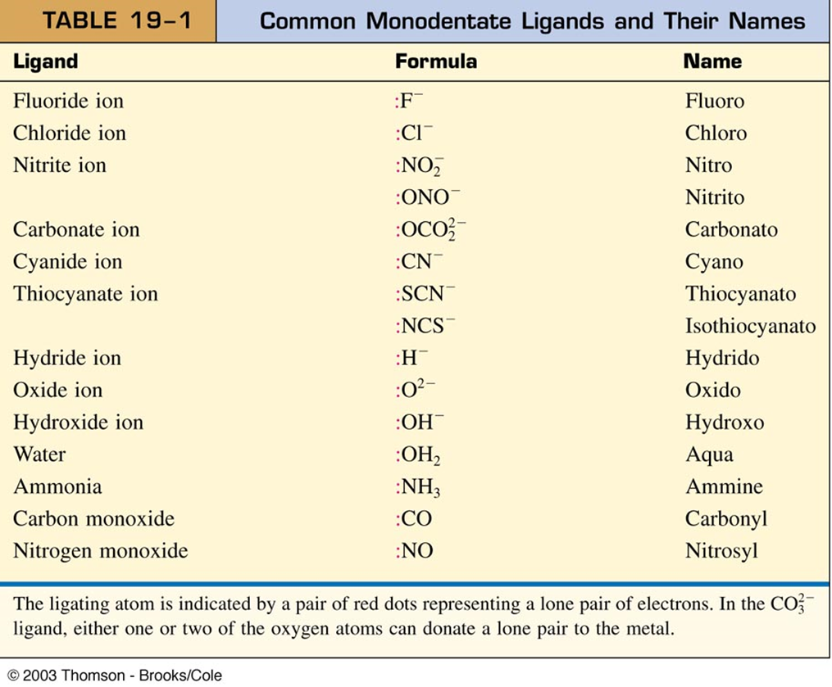
Ligands
Molecules that bind to metal with donor atoms having lone pair of electrons.
Types: Monodentate, polydentate, chelating ligands.
Influence structures, chemical reactivity, and photophysical properties.
Examples of monodentate ligands

Slide 6
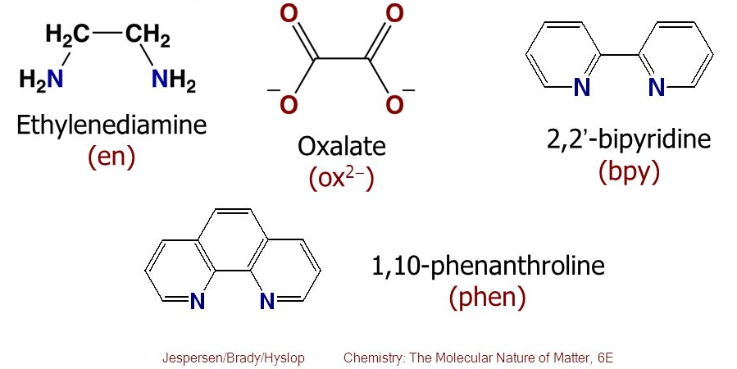
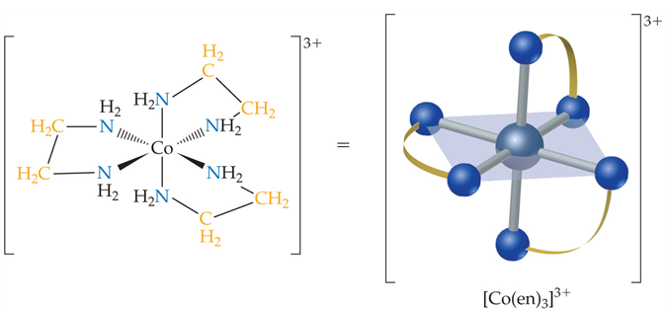
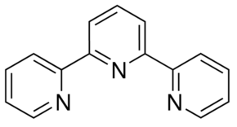
Ligands
Examples of bidentate ligands
Bidentate and polydentate ligands are also called chelating agents.
Examples of tridentate ligands
Terpyridine
(terpy)
bisethylenetriaine
(tris)

Slide 7
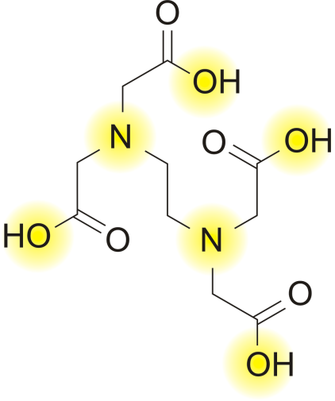
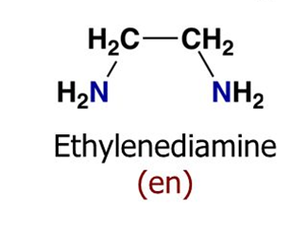
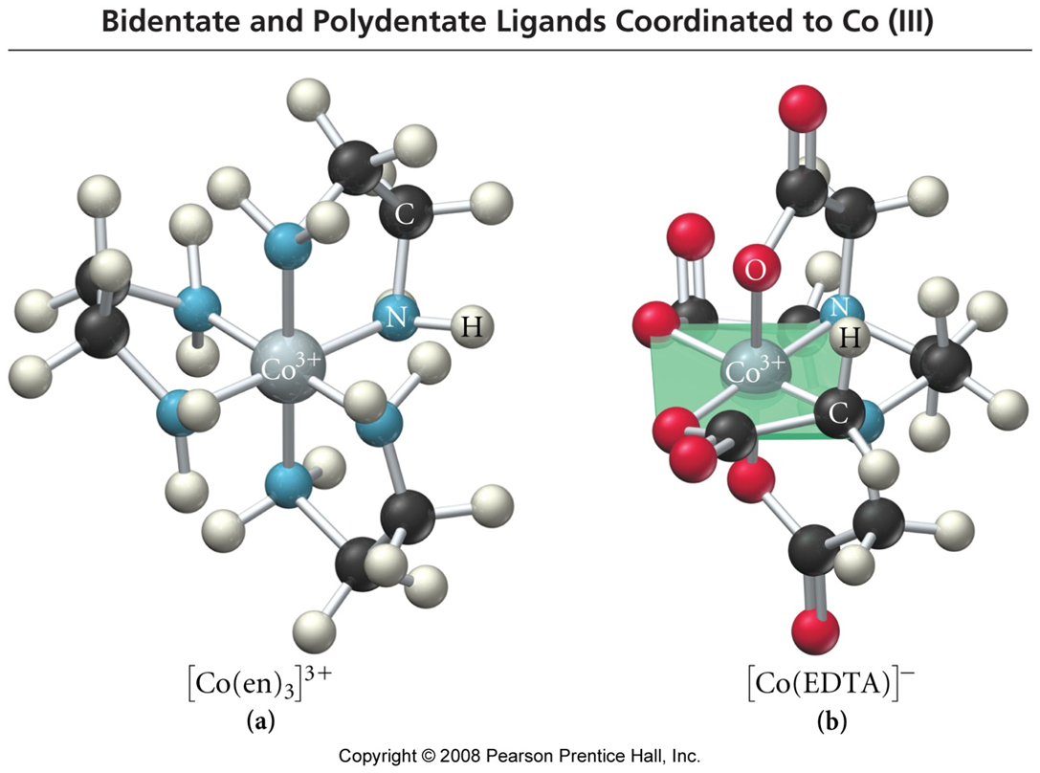
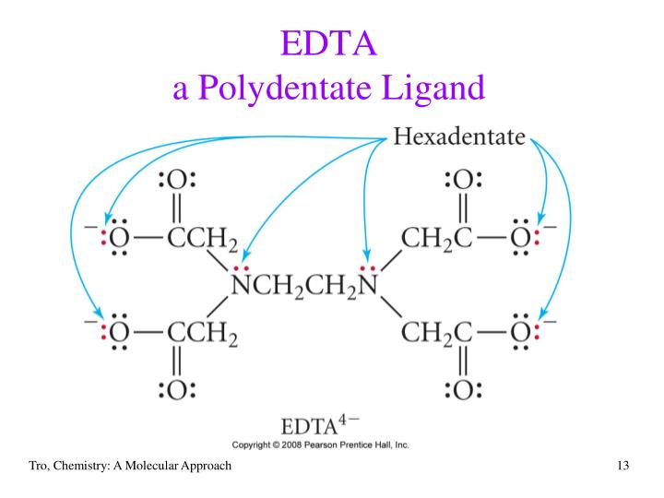
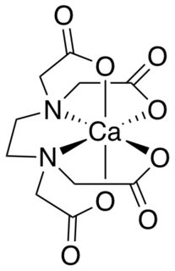
Ligands
Polydentate ligand: EDTA (Ethylenediaminetetraacetic acid)
Replace the “H” atoms
on nitrogen by acetic acid
EDTA (acid form)
-2
[Ca(EDTA)₄]⁻²

Slide 8
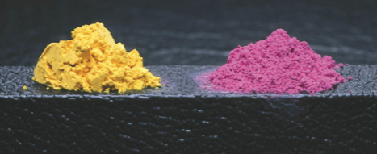
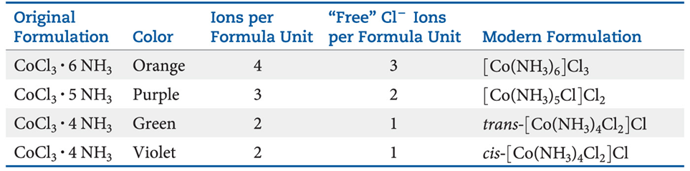

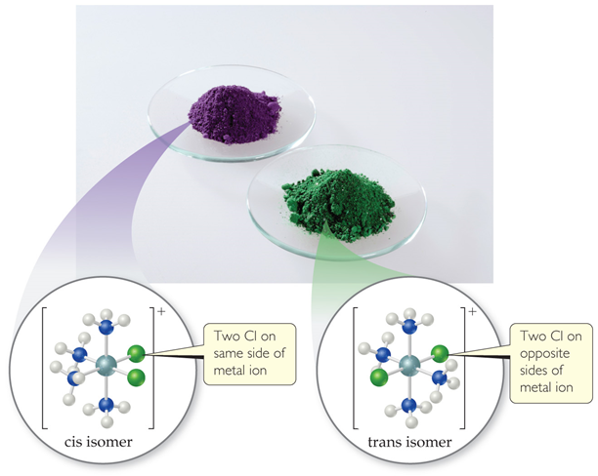
Werner’s Theory
The combination of CoCl₃ and NH₃ resulted in many compounds. Their nature was
explained by Alfred Werner in 1893.
The oxidation number of a metal is +3 in each compound. However, the number of
atoms bonded to the metal is different. He called this the coordination number.
The key to solving this problem is the number of ions produced in solution per formula unit: along with ONE cation, the rest would tell how many Cl– ions are NOT connected directly to the metal.
Precipitation of AgCl confirmed amount of free Cl–.

Slide 9
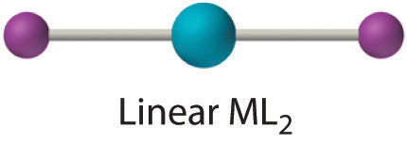
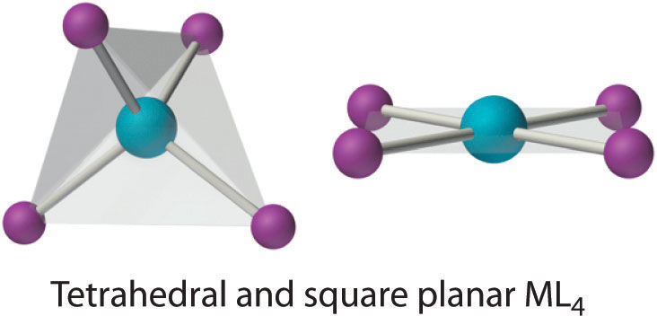
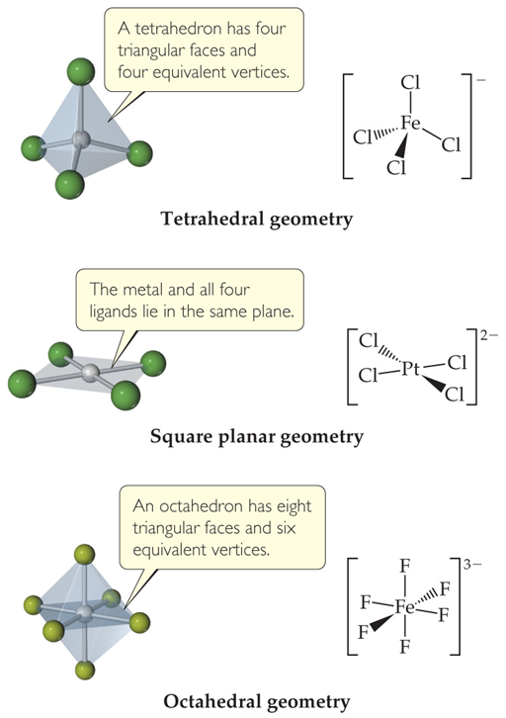
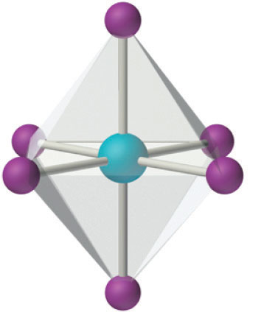
Coordination Number and Geometry
For coordination number two, a linear geometry is observed
For coordination number 4, both tetrahedral
and square planar geometries are possible
For coordination number 6, octahedral geometry is commonly
observed
Octahedral ML₆
Our discussion will focus mainly on coordination numbers 4 and 6

Slide 10
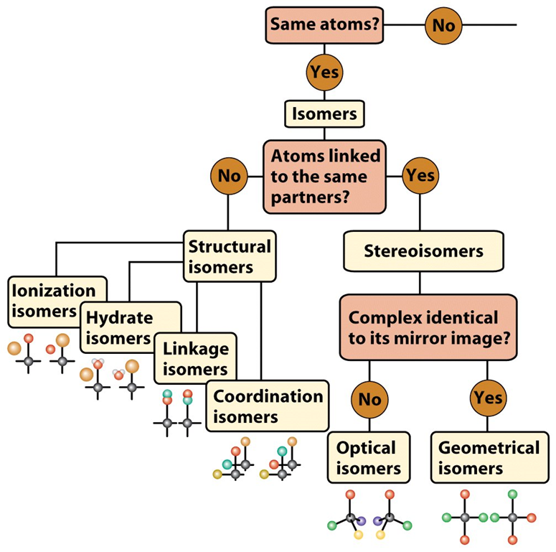
Isomerism
Isomers: Same atomic composition, different bonding arrangements

Slide 11
Isomerism
Ionization Isomerism
Interchange of an anionic ligand within the coordination sphere with an anion outside the coordination sphere.
[Cr(NH₃)₅(SO₄)]Br (Red; Gives precipitate with silver nitrate)
[Cr(NH₃)₅Br]SO₄ (Red –Violet; Gives precipitate with Barium chloride)
Coordination Isomerism
Found in compounds in which both cations and anions are complex ions, arise from interchange of ligands from the cationic part to the anionic part.
[Co(NH3)6][Cr(C2O4)3] and [Cr(NH3)6][Co(C2O4)3]
[Zn(NH3)4][CuCl4] and [Cu(NH3)4][ZnCl4]
[Pt^{II}(NH3)4][Pt^{IV}Cl6] and [Pt^{IV}(NH3)4Cl2][Pt^{II}Cl4]

Slide 12
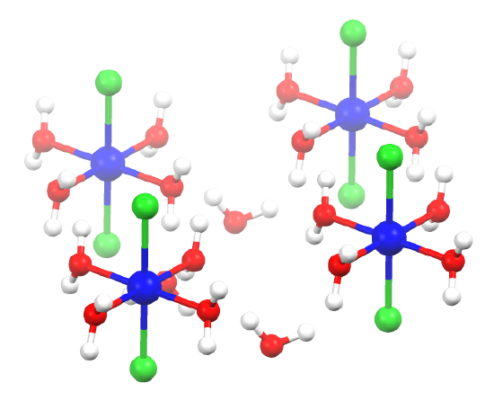
Isomerism
Hydrate Isomerism
Isomers differ in whether (or how many) water molecules are present inside or outside the coordination sphere. As an example, CrCl₃.6H₂O can be either of the three compounds below:
[CrCl₂(H₂O)₄]Cl•2H2O (bright-green)
[CrCl(H₂O)₅]Cl₂•H2O (blue-green)
[Cr(H₂O)₆]Cl₃ (violet)
The dot in the above formulas refers to water molecules that are not bound
to the central metal, but are part of the lattice.
NiCl₂•6H₂O consists of separated trans-[NiCl₂(H₂O)₄]
molecules linked more weakly to adjacent water
molecules. Only four of the six water molecules
in the formula are bound to the nickel (II) cation,
and the remaining two are waters of crystallization
as the crystal structure resolves.
crystal structure of NiCl₂•6H₂O

Slide 13
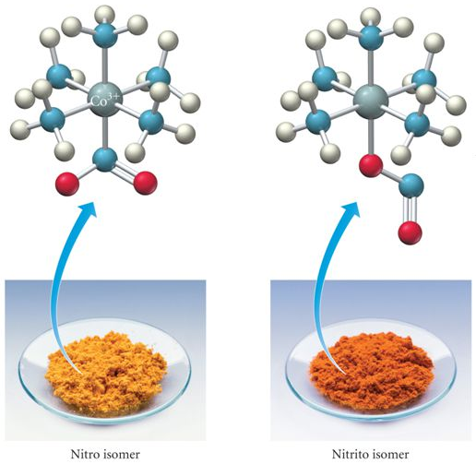
Isomerism
Linkage Isomerism
Occurs with ambidentate ligands. These ligands are capable of coordinating in more than one way. The best known cases involve the monodentate ligands SCN⁻/NCS⁻and NO₂⁻/ONO⁻.
Thiocyanate ion
Thiocyanato NCS:→
Isothiocyanato SCN:→
cyanato NCO:→
isocyanato OCN:→
cyanate ion
nitro
nitrito
[Co(NH₃)₅NO₂]Cl₂
[Co(NH₃)₅ONO]Cl₂

Slide 14
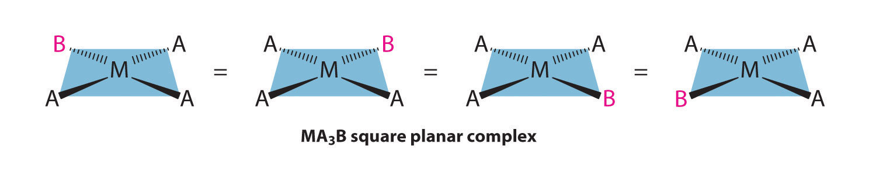
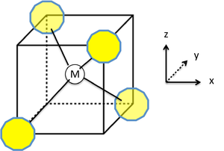
Stereoisomerism
Geometric Isomerism
Metal binds to same ligands but with different spatial arrangement. Interconversion not possible without breaking bonds.
MA₃B Case:
All the below structures are equivalent
For a tetrahedral complex, there are no geometric isomers (all 4 structures below are equivalent (same).

Slide 15
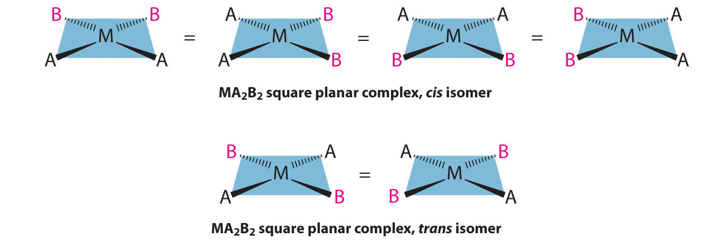
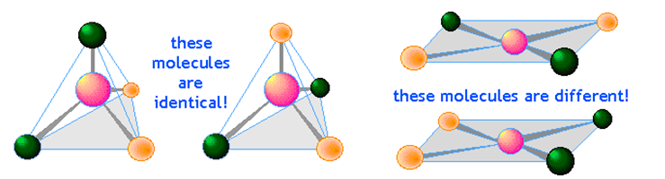
Stereoisomerism
Geometric Isomerism
Metal binds to same ligands but with different spacial arrangement. Interconversion not possible without breaking bonds.
MA₂B₂ Case:

Slide 16
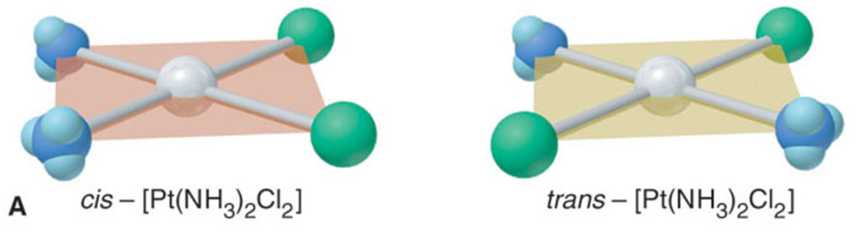
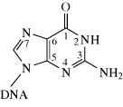
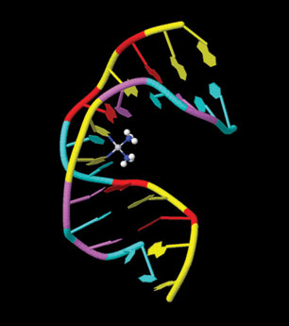
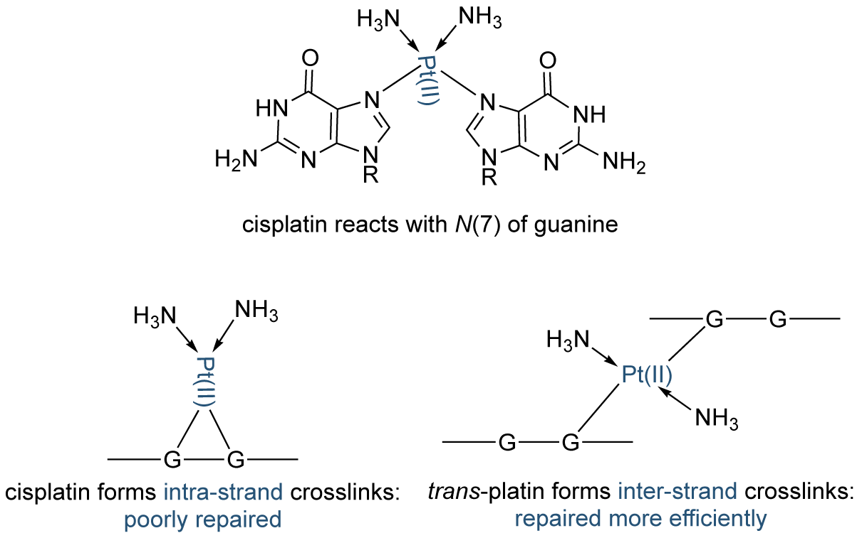
Stereoisomerism
Two geometric isomers can behave very differently
cisplatin
Anti-cancer agent
transplatin
No activity against cancer

Slide 17
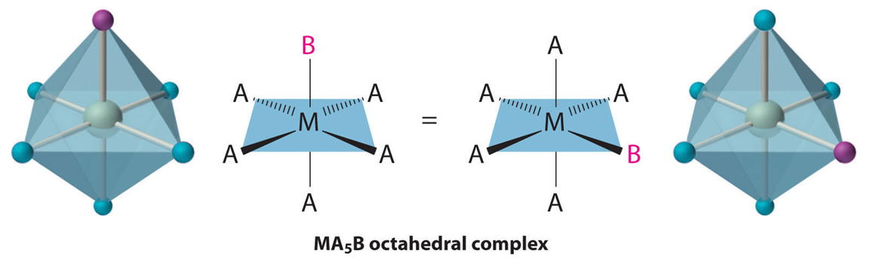
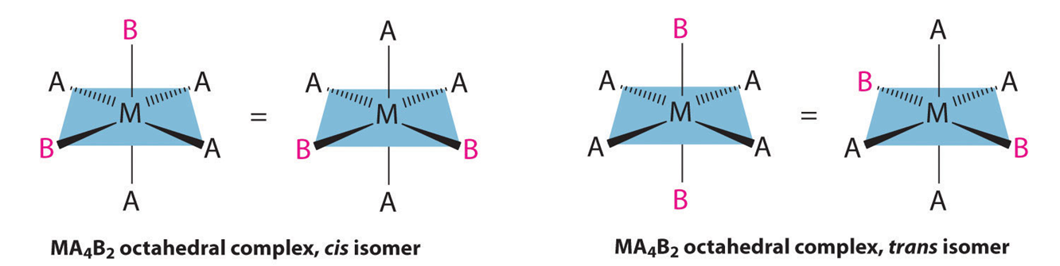
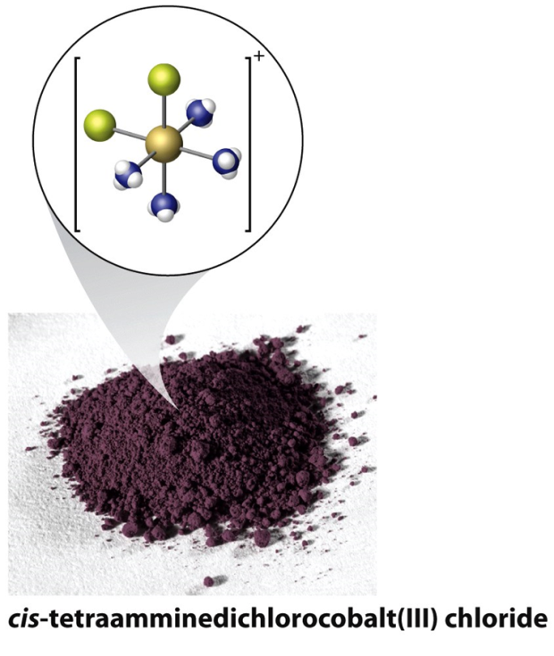
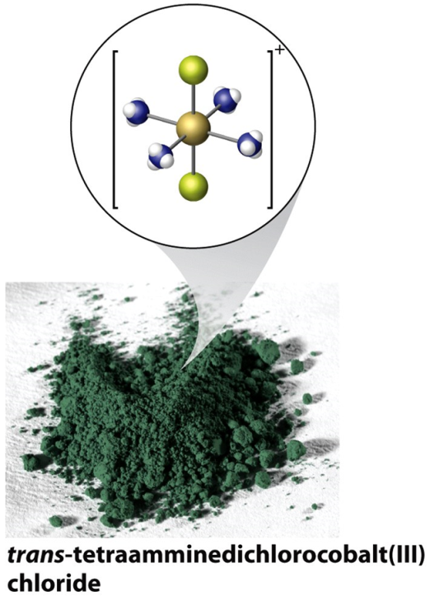
Stereoisomerism
Octahedral Complexes
MA₅B Case:
MA₄B₂ Case:
cis-[Co(NH₃)₄Cl₂]Cl
trans-[Co(NH₃)₄Cl₂]Cl

Slide 18
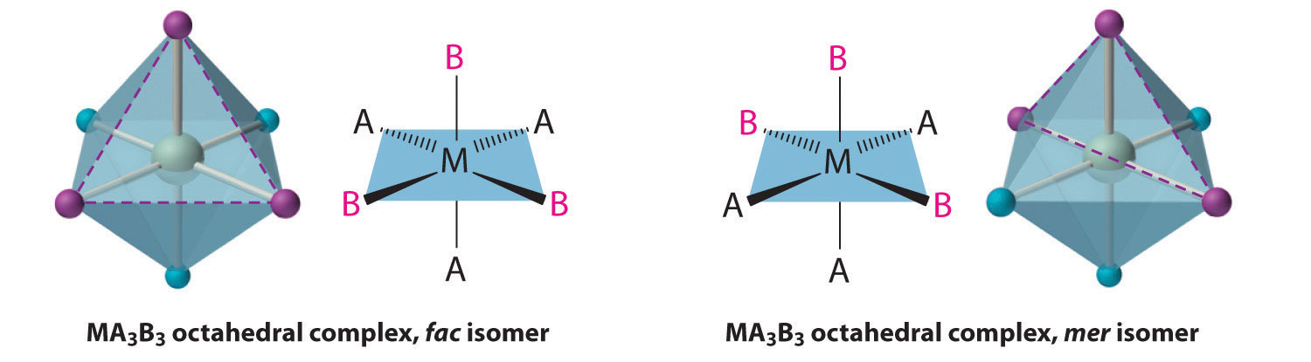
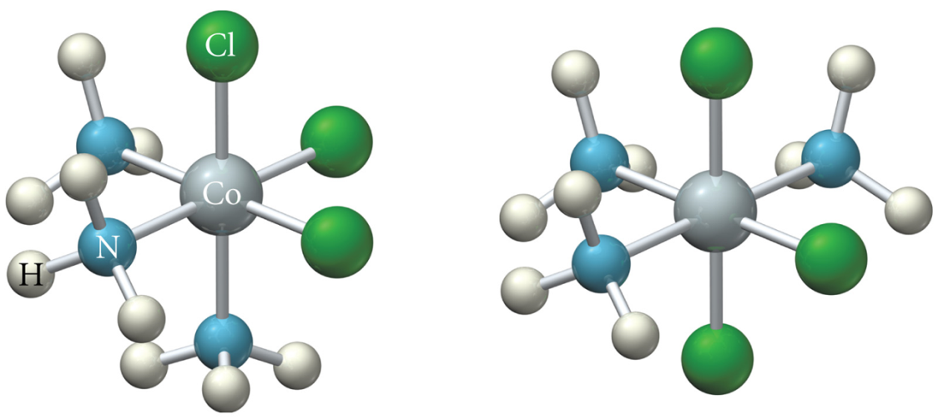
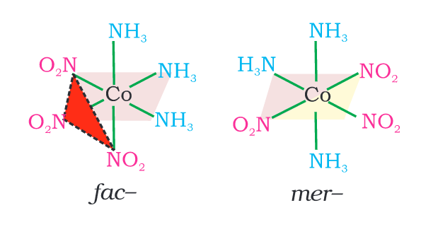
Stereoisomerism
Octahedral Complexes
MA₃B₃ Case: facial and meridional isomers
fac-isomers have 3 identical ligands on one triangular face
mer-isomers have 3 identical ligands in a plane bisecting the molecule
fac- isomer
mer- isomer
[Co(NH₃)₃Cl₃]
[Co(NH₃)₃(NO₂)₃]

Slide 19
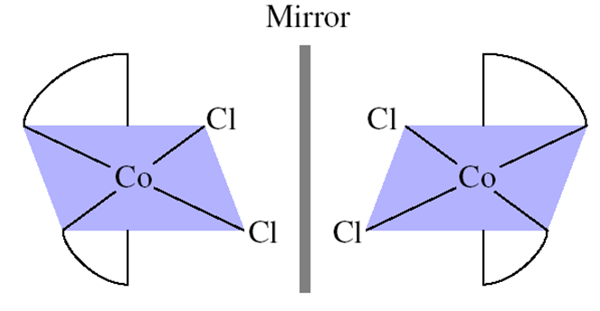
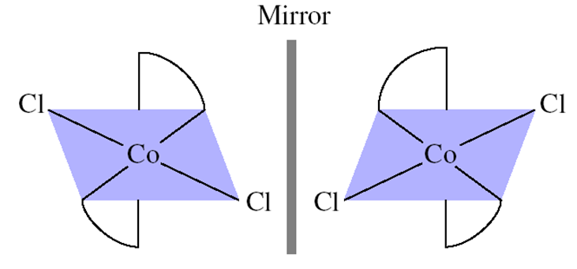
Stereoisomerism
Octahedral Complexes
M(A-A)₂B₂ Case: [Co(en)₂Cl₂]⁺ has three stereoisomers
cis-
trans-
But…this situation is not so simple…
Mirror plane
Mirror plane
trans-
cis-
Non-superimposable mirror images
superimposable mirror images
The cis- form is an enantiomeric pair.

Slide 20
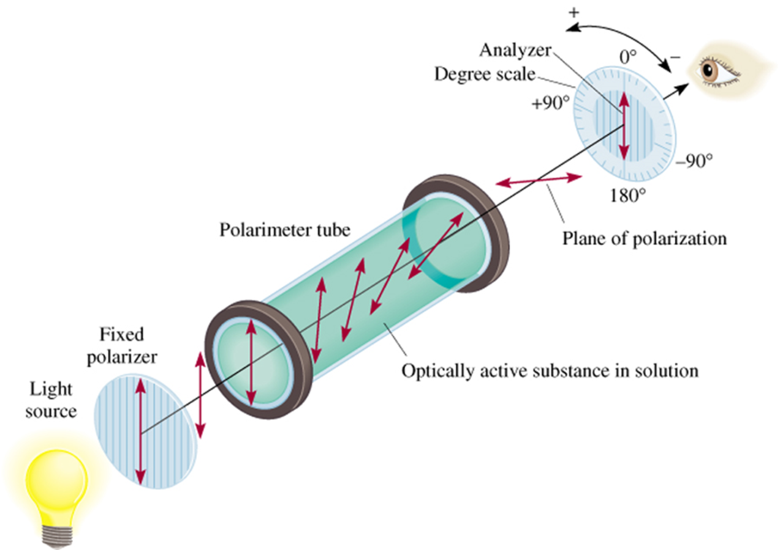
Stereoisomerism
Optical Isomerism
Optical isomers, or enantiomers, are mirror images of one another that don’t superimpose on each other.
They are said to be chiral.
Their properties differ from each other only when in contact with other chiral substances.

Slide 21



An Interesting Side-Note About Enantiomers
How can we distinguish the following two enantiomers?
There are more such enantiomeric pairs!

Slide 22



Stereoisomerism
Optical Isomerism
Do we need to draw mirror images every time we want to think about
enantiomers?
Enantiomers do not have a plane of symmetry
Any molecule which possesses a plane of symmetry is superimposable on its mirror image
The trans- isomer indeed has a plane
of symmetry

Slide 23





Stereoisomerism
Optical Isomerism
cis-

Slide 24



Stereoisomerism
Optical Isomerism
rotation of I by 90° gives III = II

Slide 25


Stereoisomerism
Octahedral Complexes
M(A-A)₃Case: [Co(en)₃]³⁺
enantiomers

Slide 26




Stereoisomerism
Octahedral Complexes
MA₂B₂C₂Case: (there are other geometric isomers as well; work it out)
enantiomers

Slide 27



Bonding in Coordination Compounds
Valence Bond Theory
Proposed by Linus Pauling (Nobel Prize 1954) for nature of chemical bonds and elucidation of structure of complex systems.
The model utilizes hybridization of metal valence orbitals to account for the observed structures and magnetic properties of complexes. (n-1)d, ns and np undergo hybridization to give hybridized orbitals. An empty hybrid orbital on the metal center can accept a pair of electrons from a ligand to form a σ-bond.

Slide 28
Valence Bond Theory: Limitations
Limitations of Valence Bond Theory
Electronic and spectroscopic properties (color) of coordination complexes is not explained.
Quantitative interpretation of magnetic data is possible.
Whether a complex of coordination number four is square planar or tetrahedral cannot be exactly predicted.
Effect of ligands of different donor ability is neglected or high-spin and low-spin complexes cannot be distinguished.

Slide 29
Crystal Field Theory (CFT)
Assumptions/Features of CFT
The interaction between the metal ion and the ligand is assumed to be purely
electrostatic (ionic) in nature.
The ligands are treated as point charges.
Examines the energetics (splitting) of d-orbitals in certain geometries.
Nature of Interaction between Metal and Ligand
The approaching ligand is considered to be a point charge repelled by the
electrons in a metal’s d-orbitals.
Therefore, the d orbitals on a metal in a complex would not remain degenerate.
Those that point toward ligands would be higher in energy than those that do not.

Slide 30

d-Orbitals
These three atomic orbitals
point in between the axes
These two atomic orbitals
point along the axes

Slide 31



Metal Ion in an Octahedral Field
The corners of octahedron are assumed to be placed on the axes.
The ligands approach along the axes and occupy the corners
Electrons in the d orbitals lying along the axes are repelled the most, while those lying in between the axes are less repelled

Slide 32



t_{2g}: triply degenerate set of orbitals
e_{g}: doubly degenerate set of orbitals
g = gerade; symmetric with respect to center
of inversion
u = ungerade; antisymmetric w.r.t. center of inversion
0.6 Δ_{o}
Barycenter
0.4 Δ_{o}
Δ_{o} = crystal field splitting parameter; The energy separation between the two
levels is denoted by Δ_{o} or 10 Dq.
The higher energy set of orbitals (d_{z2} and d_{x2-y2}) are labeled as e_{g} and the lower
energy set is labeled as t_{2g}. These notations are based on the symmetry of the orbitals.
To maintain the average energy, the e_{g} orbitals need to be destabilized by 0.6 Δ_{o} (6 Dq)
and the t_{2g} orbitals to be stabilized to the extent of 0.4 Δ_{o} (4 Dq)

Slide 33

The Complete Picture

Slide 34





Tetrahedral Field
“t_{2”} set
“e” set
No orbitals directly pointing toward the ligands.
The e orbitals point between the two ligands present at opposite corners of a
cube (thereby being less effected than the t₂ orbitals).
The t₂ orbitals lie half an edge of the cube from ligand and point more directly
toward ligands (destabilized).

Slide 35




Tetrahedral Field
Δ
Δ
Δ
Spherical field
tetrahedral field
The crystal field splitting in the tetrahedral field is intrinsically smaller than in the
octahedral field. For most purposes the relationship may be represented as Δ_{t} = 4/9 Δ_{o}

Slide 36
Comparison of Octahedral and Tetrahedral Fields

